Slide 1
SKEW LINES
BY
K. SHALINI
LECTURER IN MATHEMATICS
SKR & SKR COLLEGE FOR WOMEN,
KADAPA

Slide 2
OBJECTIVES
Introduction
Oblique lines
Parallel lines
Perpendicular lines
Skew lines
: 3d Geometry
: in real life examples
Difference between parallel lines and skew lines
Shortest Distance between the skew lines
Problems on skew lines
Applications
conclusion

Slide 3
INTRODUCTION
Point :- Indicates a location and has no size
Segment :- Part of a line between two points
Plane:- Represented by a flat surface that
extends forever in all directions
Line :- Represented by a straight path
that
extends in two opposite directions without end and has no thickness. A line contains infinitely many points.

Slide 4
PLANES
Plane:- Plane is a flat two dimensional surface with no thickness, that extends infinitely. It can be recognized by three points on a surface that is not on the same line.
Real Life examples:
A piece of paper.
Wall.
White-board.
A note card.
Desktop.

Slide 5
EQUATION OF A PLANE IN 3D
A plane in three-dimensional space has the equation
ax+by+cz+d=0
where at least one of the numbers a, b, and c must be non-zero. A plane in 3D coordinate space is determined by a point and a vector that is perpendicular to the plane.
The equation of a plane through a
point A=(x1,y1,z1) whose normal vector n=(a,b,c) is
a(x−x1)+b(y−y1)+c(z−z1)=0

Slide 6
EXAMPLE:
If a plane is passing through the point A=(1,3,2) and has normal vector n =(3,2,5), then what is the equation of the plane?
The equation of the plane which passes through A=(1,3,2) and has normal vector n=(3,2,5) is
a(x−x1)+b(y−y1)+c(z−z1)=0
3(x−1)+2(y−3)+5(z−2)=0
3x−3+2y−6+5z−10=0
3x+2y+5z−19=0

Slide 7
LINES
Line: When two points extend infinitely in the opposite direction then it is called a line. The line is denoted by showing two arrowheads going in the opposite direction.
Real-Life Examples:
Time.
Lines of latitude and longitude.
The center-line on a highway.
The Equator.

Slide 8
EQUATION OF LINE IN 3D
In three dimensional geometry, a straight line is defined as the intersection of two planes. So general equation of straight line is stated as the equations of both plane together i.e. general equation of straight line is
a1x + b1y + c1z + d1 = 0, a2x + b2y + c2z + d2 = 0
……(1)
So, equation (1) represents straight line
which is obtained by intersection of two planes.

Slide 9
DIFFERENT FORMS OF LINES
Symmetrical Form of a line:
Equation of straight line passing through point P (x1, y1, z1) and whose direction cosines are (l, m, n) is
(x–x1)/l = (y – y1)/m = (z – z1) / n.
Equation of straight line passing through two points P (x1, y1, z1) and Q (x2, y2, z2) is
x–x1 / x2– x1 = y–y1 / y2 – y1 = z – z1 / z2 – z1
Section formula: If P(x, y) divides the line joining A(x1, y1) and B(x2, y2) in the ratio of m:n then,
x = (mx2 + nx1)/ (m+n) and y = (my2 + ny1)/ (m+n)
Intercept form: If a straight line makes an intercept of say ‘a’ and ‘b’ on x and y axis respectively, then the equation of the straight line is given as
x/a + y/b = 1

Slide 10
EQUATION OF LINE
The equation of a line through a point (2,3,4) (1,2,3)
is given by the formula
x–x1 / x2– x1 = y–y1 / y2 – y1 = z – z1 / z2 – z1 X-2/1-2=y-3/2-3=z-4/3-4
X-2/-1=y-3/-1=z-4/-1 X-2=y-3=z-4

Slide 11
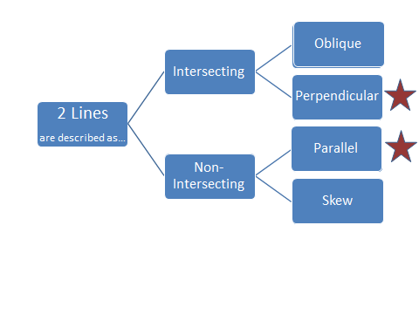

Slide 12
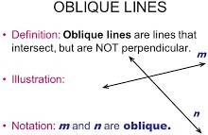

Slide 13
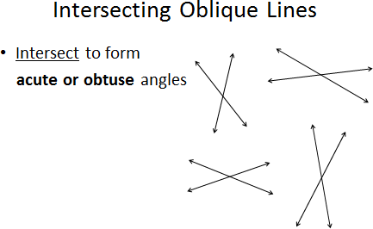
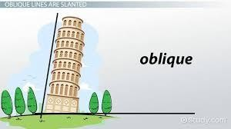

Slide 14
PARALLEL LINES
Parallel Lines: When two lines extend together by maintaining the same distance between themselves which never share an intersecting point, then they are called parallel lines.
Real-Life Examples:
Railway tracks.
The lines of running tracks.
Lines on a road.
The opposite sides of a book.

Slide 15
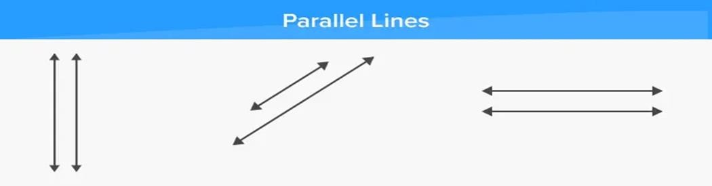
Parallel lines are two lines that are always the same distance apart and never touch. In order for two lines to be parallel, they must be drawn in the same plane, a perfectly flat surface like a wall or sheet of paper. Here, three set of parallel lines have been shown - vertical, diagonal and horizontal parallel lines.
Sides of various shapes are parallel to each other. Parallel lines are represented with a pair of vertical lines between the names of the lines, such as PQ ︳︳XY.

Slide 16
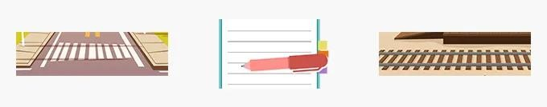

We can see parallel lines in a zebra crossing, the lines of notebook and in railway tracks around us.
Each line can have many parallel lines to it.
Parallel lines can be extended indefinitely, with out them intersecting at any point.

Slide 17
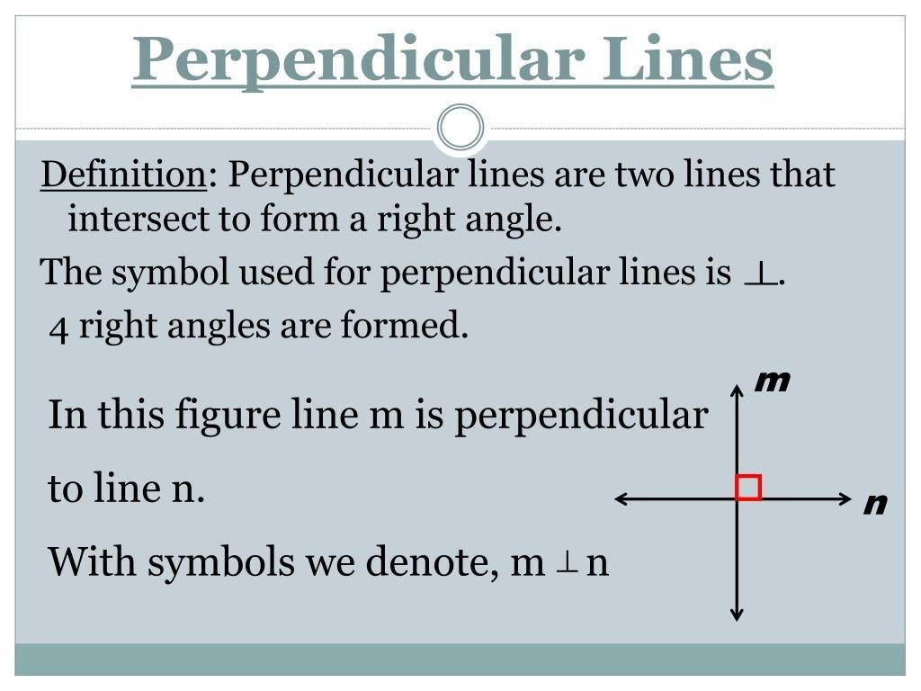

Slide 18
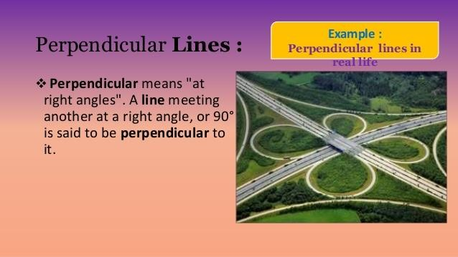

Slide 19
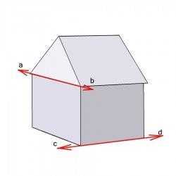
SKEW LINES
In three-dimensional geometry, skew lines are two lines that do not intersect and are not parallel.
Skew lines are straight lines in a three dimensional form which are not parallel and do not cross.
An example of skew lines are the sidewalk in front of a house and a line running across the top edge of a side of a house.
Lines ab and cd are skew lines.

Slide 20
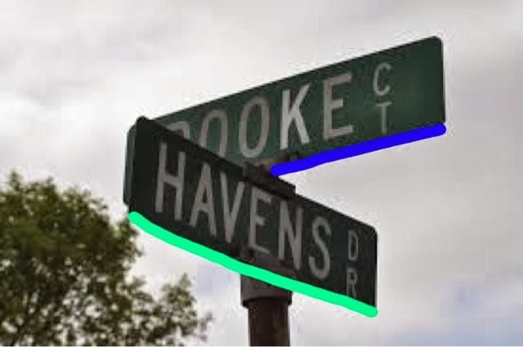
Example: A street sign is an example of skew lines in real life.
Two street signs, they do not intersect, they are not parallel, and the lines are straight. The sign contains a pair of skew lines because the two lines do not intersect and are not parallel or coplanar (one line is in blue and one line is in green). Street signs are very important to drivers. Street signs give people sense of direction and where one is located.

Slide 21
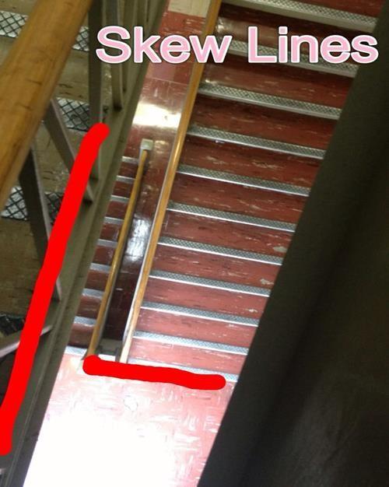
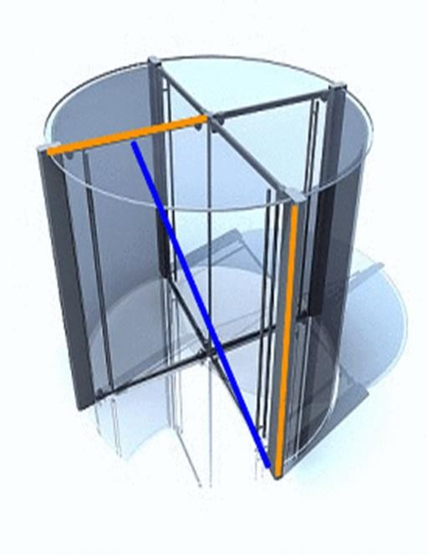
Since skew lines have to be in different planes, we need to think in 3-D to visualize them. However, it is often difficult to illustrate three-dimensional concepts on paper or a computer screen. Let's look at a few examples to help you see how skew lines appear in diagrams.

Slide 22
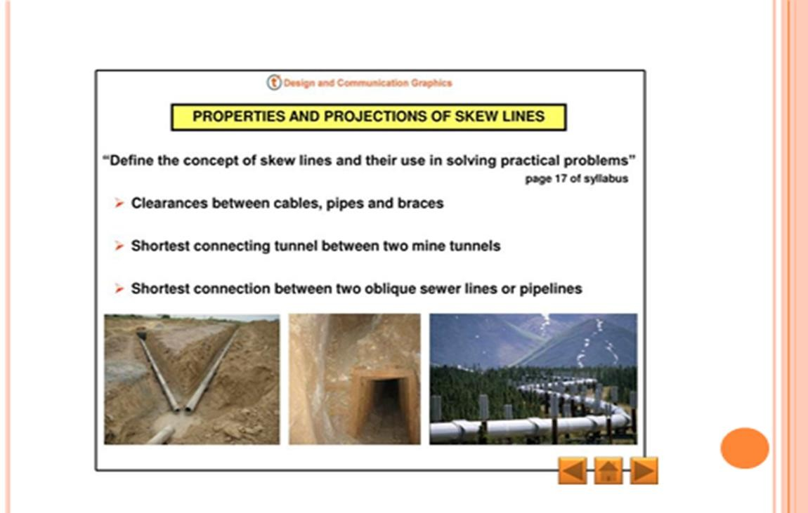

Slide 23
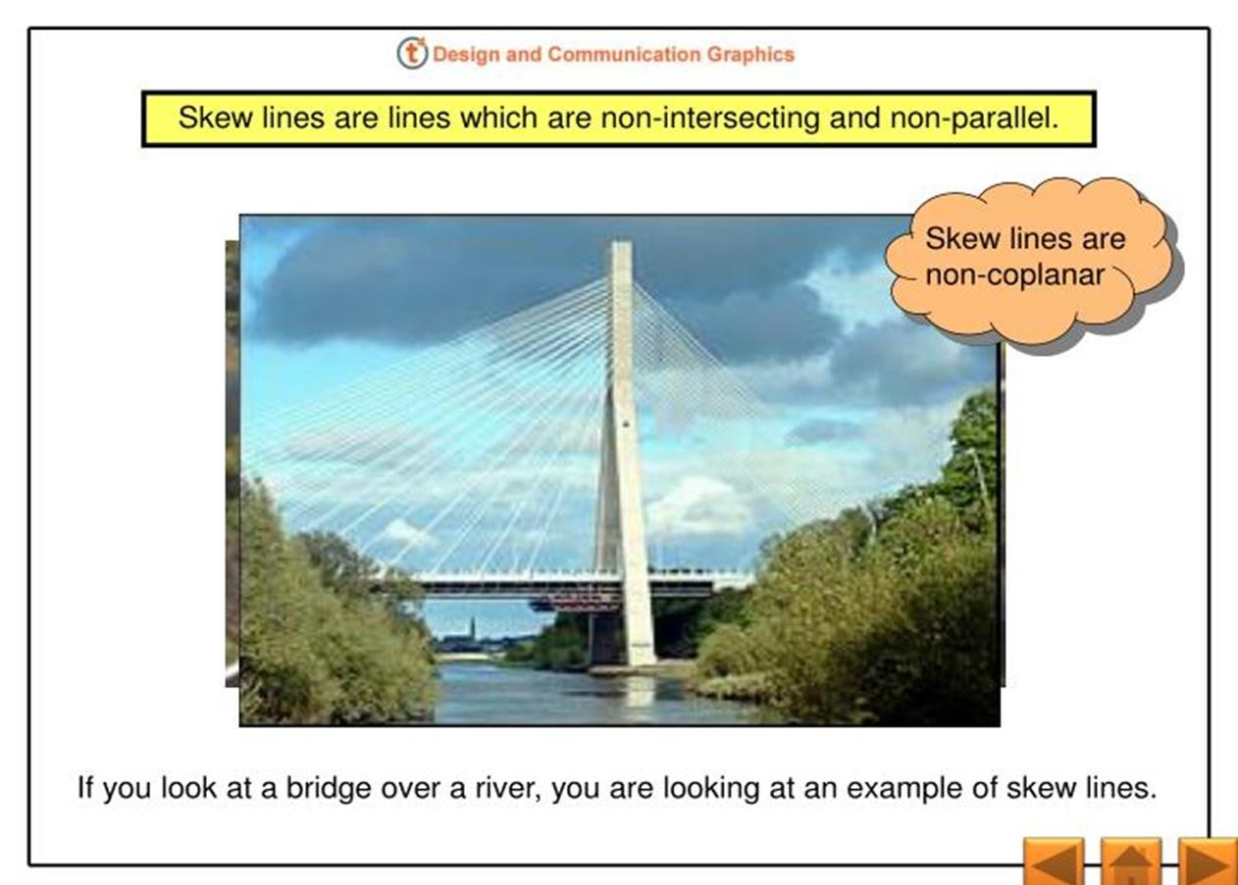

Slide 24
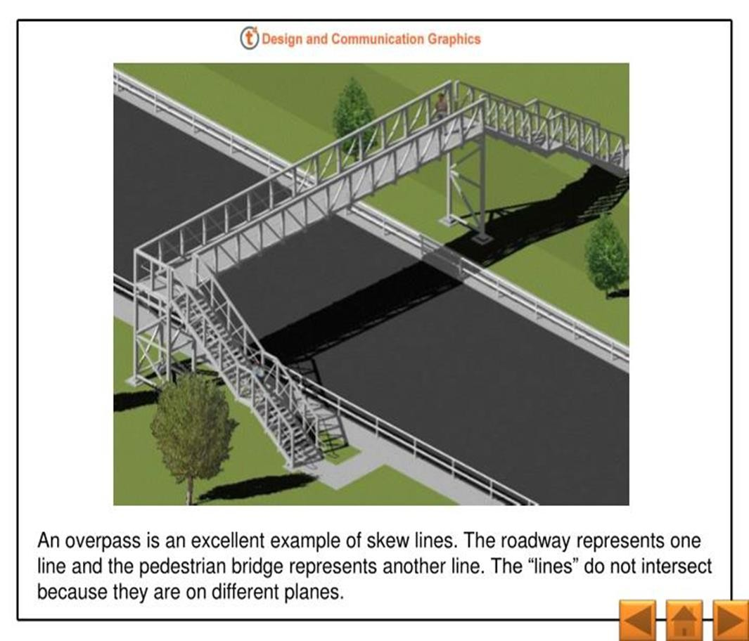

Slide 25
Difference between Parallel and Skew lines
Two or more lines are parallel when they lie in the same plane and never intersect. ... Skew lines are lines that are in different planes and never intersect.
The difference between parallel lines and skew lines is parallel lines lie in the same plane while skew lines lie in different planes.

Slide 26
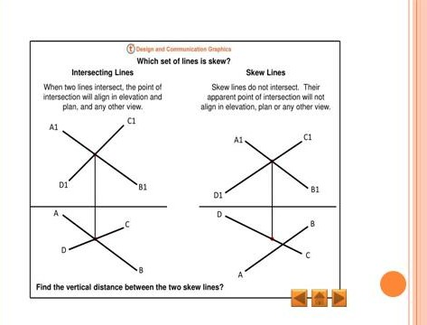

Slide 27
Skew Lines in 3-D Geometry
In three-dimensional geometry, we are always dealing with objects in the three-dimensional Cartesian space. One of the key elements of three-dimensional geometry is the straight line, also sometimes simply referred to as a line.
There can be various ways in which two lines are related in the three-dimensional space. Our focus in the following section shall be on skew lines. The objective is to find out how to measure the distance between such skew lines.
Note that in case the two skew lines are intersecting, the shortest distance between them must necessarily be zero. The other cases are that of parallel lines and skew lines. Skew Lines are basically, lines that neither intersect each other nor are they parallel to each other in the three-dimensional space.

Slide 28
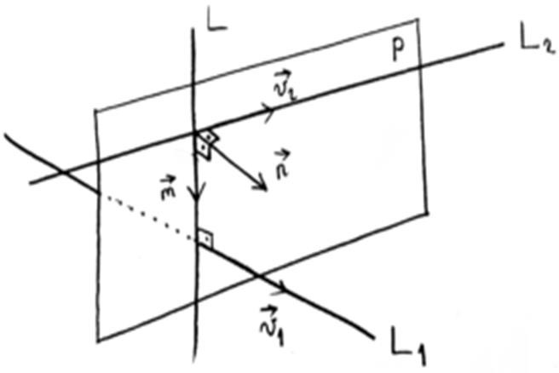
SHORTEST DISTANCE BETWEEN SKEWLINES
The shortest distance between skew lines is equal to the length of the perpendicular between the two lines.
Look at the figure below. You can see two lines from the three- dimensional Cartesian plane. As is evident from the figure, the shortest distance between the lines is one which is perpendicular to both the lines as compared to any other lines that joins these two skew lines.

Slide 29
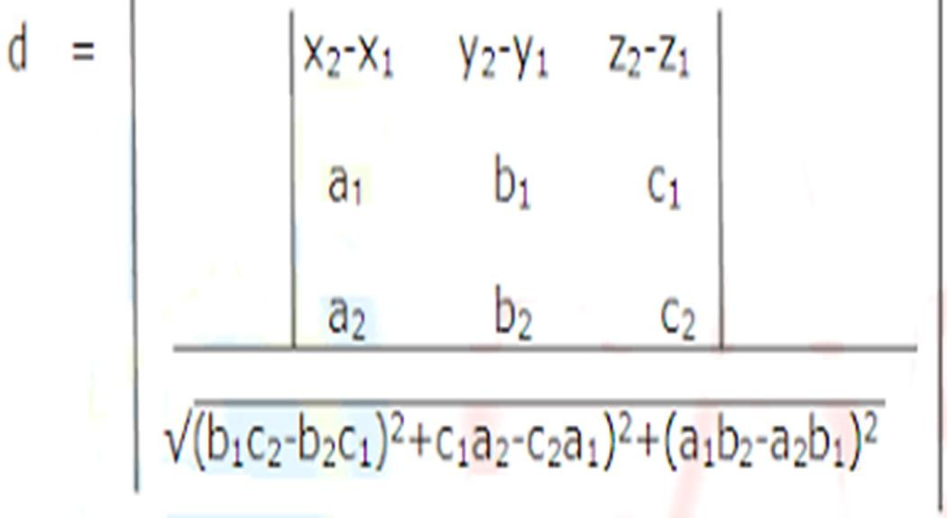
FORMULA: TO FIND DISTANCE BETWEEN SKEW
LINES

Slide 30
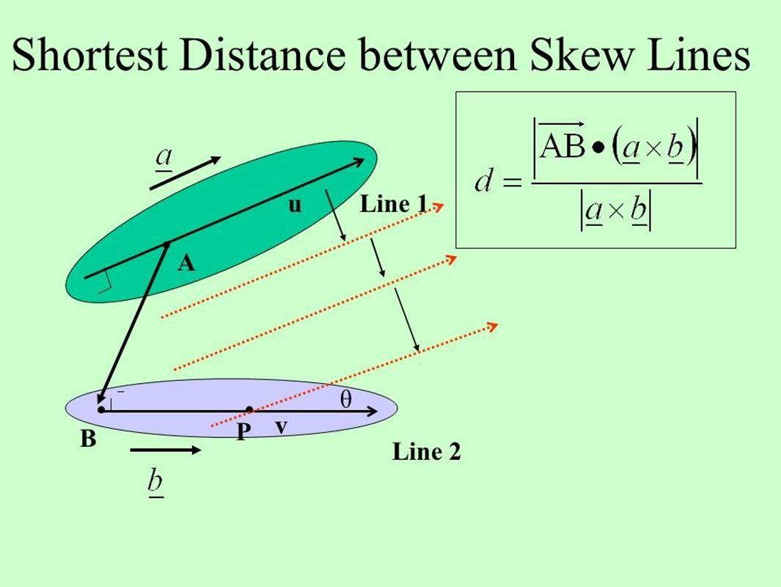
We will now move on to how the shortest distance i.e. the length of the perpendicular to two skew lines can be calculated in Vector form and in Cartesian form.

Slide 31
Vector Form
We shall consider two skew lines, say l1 and l2 and we are to calculate the distance between them. The equations of the lines are:
r⃗ 1=a⃗ 1+t.b⃗ 1
r⃗ 2=a⃗ 2+t.b⃗ 2
P = a⃗ 1 is a point on line l1 and Q = a⃗ 2 is a point on line l1. The vector from P to Q will be a⃗ 2–a⃗ 1. The unit vector normal to both the lines is given by,
(b⃗ 1×b⃗ 2)/|b⃗ 1×b⃗ 2|
Then, the shortest distance between the two skew lines will be the projection of PQ on the normal, which is given by
d=|(a⃗ 2–a⃗ 1).(b⃗ 1×b⃗ 2)|/|b⃗ 1×b⃗ 2|
where d measures the distance or the length of the
perpendicular.

Slide 32

Cartesian Form
Let us consider two lines whose equations are given by:
(x–x1)/a1=(y–y1)/b1=(z–z1)/c1
(x–x2)/a2=(y–y2)/b2=(z–z2)/c2
Then the shortest distance between these lines, when calculated using the Cartesian equations, is given by

Slide 33
Solved Example
Question: Find the shortest distance between the lines whose equations are:
r⃗ 1=i⃗ +j⃗ +λ(2i⃗ –j⃗ +k⃗ )
r⃗ 2=2i⃗ +j⃗ –k⃗ +μ(3i⃗ –5j⃗ +2k⃗ )
Answer: We shall compare the given equations with the standard form
a1=i⃗ +j⃗ ,b1=2i⃗ –j⃗ +k⃗
a2=2i⃗ +j⃗ –k⃗ ,b2=3i⃗ –5j⃗ +2k⃗
So, we can find the shortest distance as :
d=|[(2i⃗ –j⃗ +k⃗ )×(3i⃗ –5j⃗ +2k⃗ )].(i⃗ –k⃗ )|/|(2i⃗ –j⃗ +k⃗
)×(3i⃗ –5j⃗ +2k⃗ )|
= | 3 – 0 + 7 | / (59)1/2
= |10| / (59)1/2
is the shortest distance between the given lines.

Slide 34
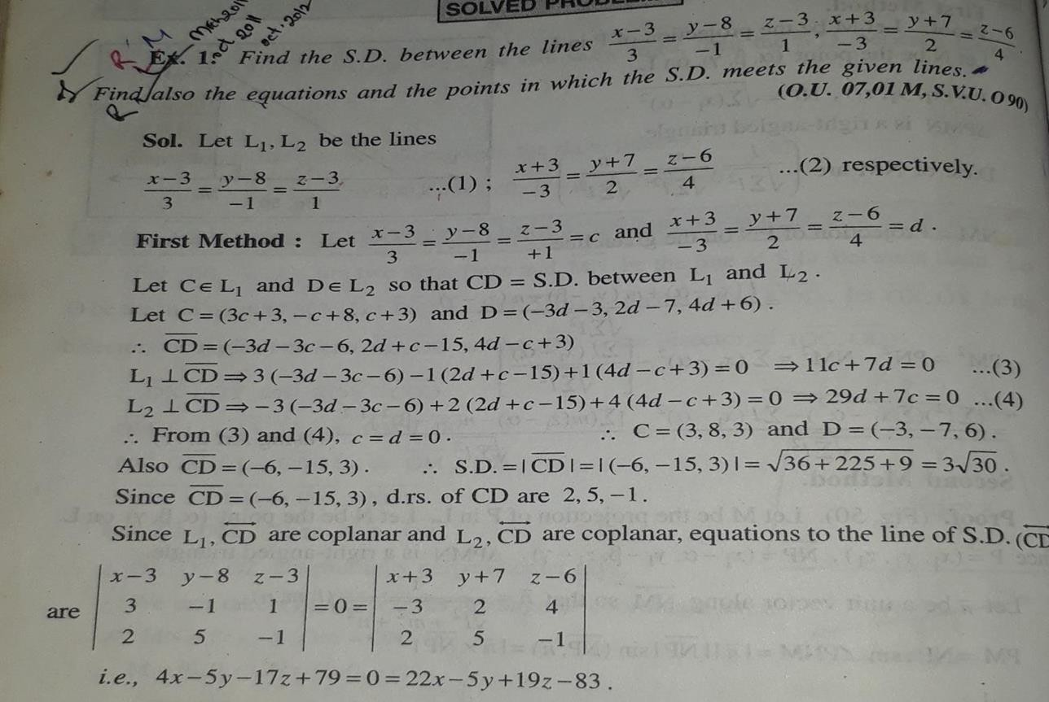
SHORTEST DISTANCE BETWEEN TWO LINES IN SYMMETRICAL FORM

Slide 35
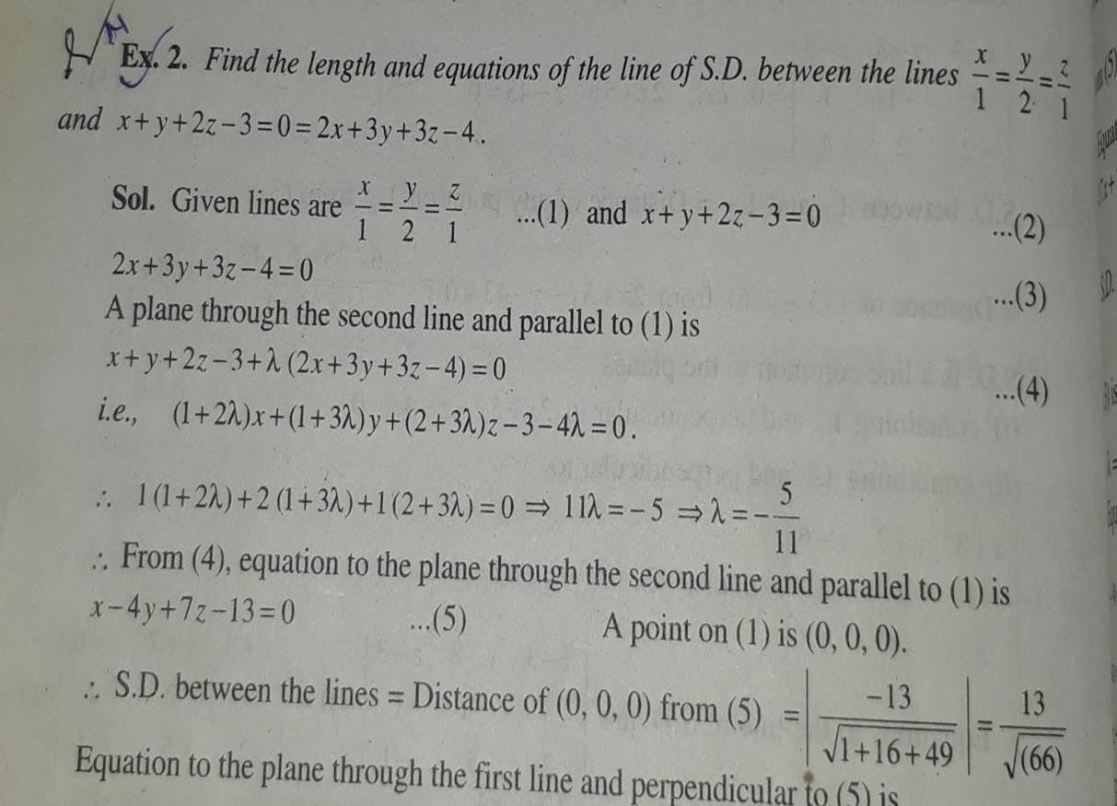
SHORTEST DISTANCE BETWEEN LINES(SYMMETRICAL AND UN SYMMETRICAL)

Slide 36
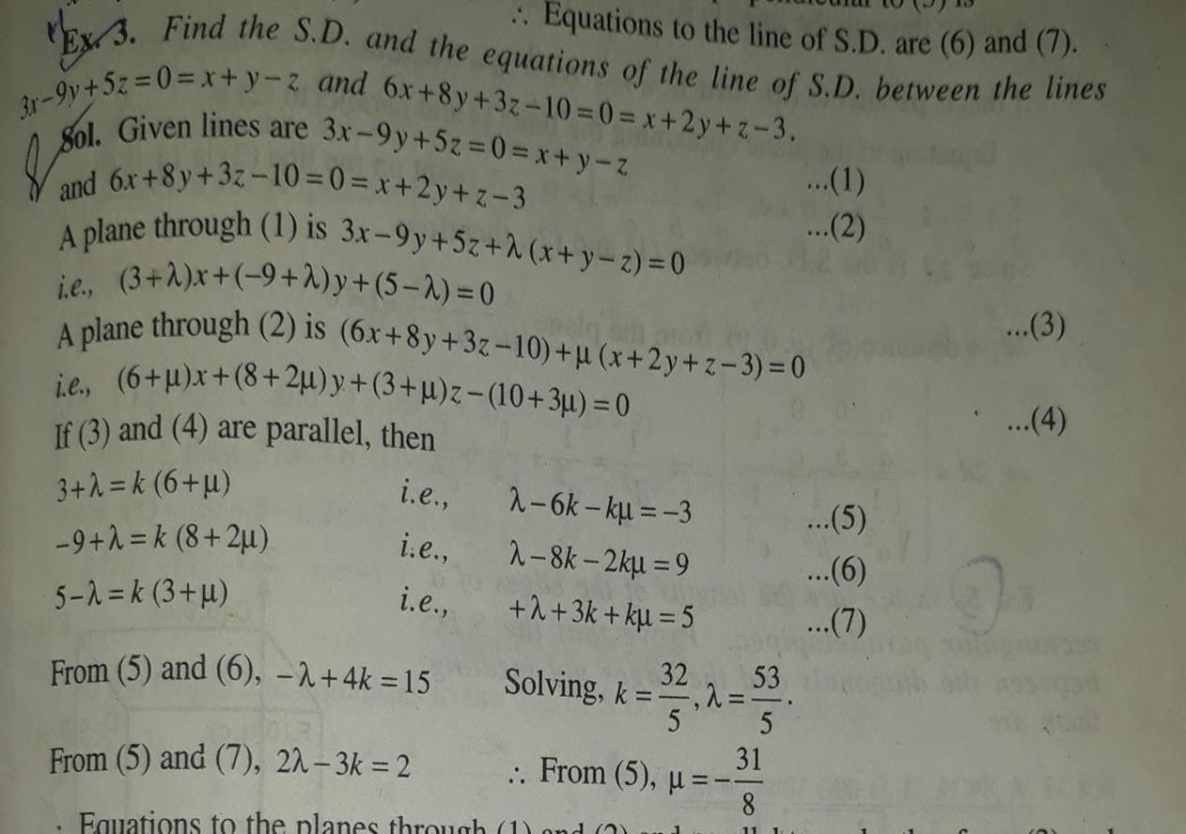
SHORTEST DISTANCE BETWEEN LINES(TWO UNSYMMETRICAL LINES)

Slide 37
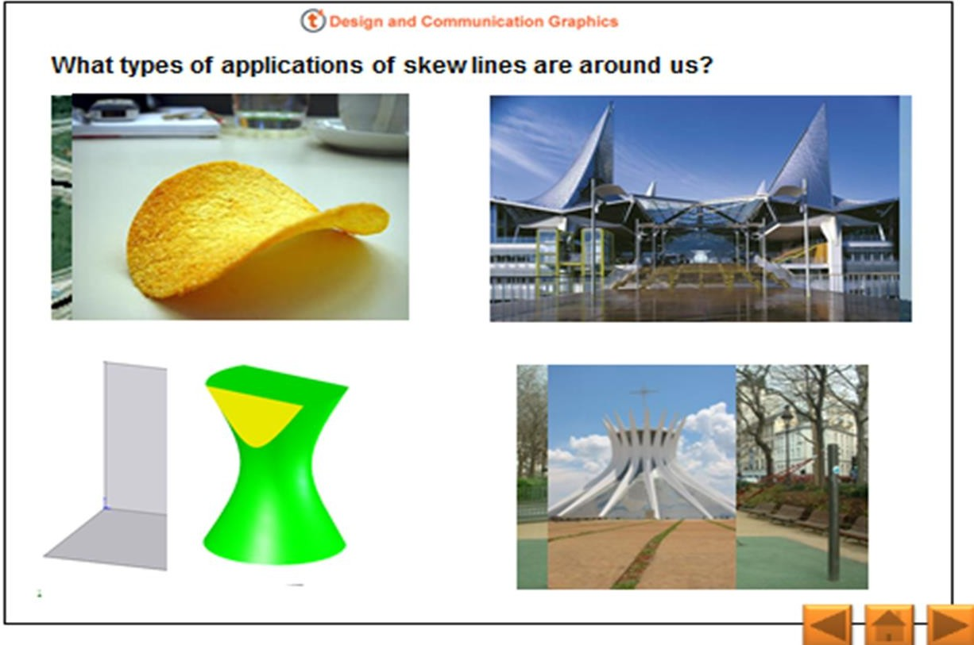
APPLICATIONS OF SKEW LINES

Slide 38
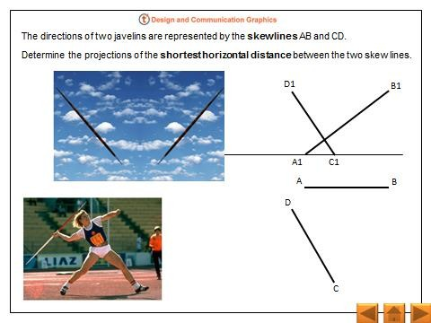

Slide 39
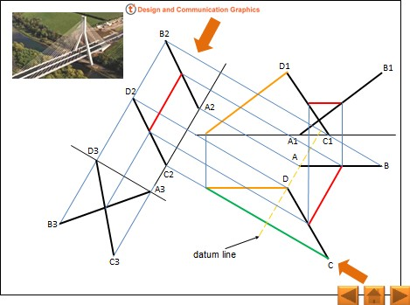

Slide 40
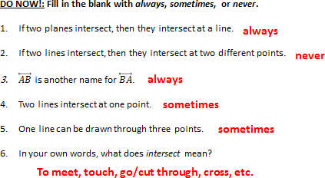

Slide 41
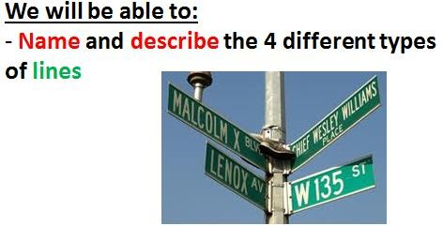

Slide 42
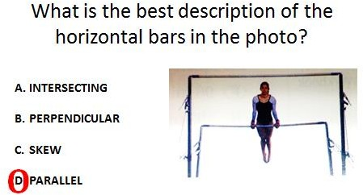

Slide 43
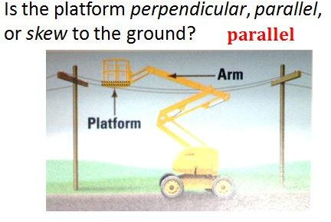

Slide 44
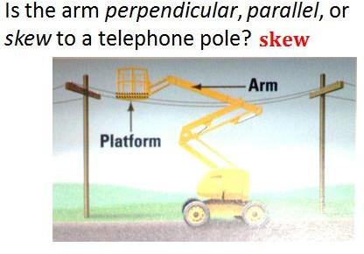

Slide 45
CONCLUSIONS
If two lines are skew, they do not lie in the same plane, because any two lines in the same plane, either intersect or parallel to each other. Skew lines exist only in three or more dimensions.

Slide 46


